Slide 1

A Multi-Modal AI Framework for Climate-Aware Crop Yield Forecasting and Smartphone-Based Disease Detection
Explainable Predictions for Smallholder Farmers
Authors: Abu Sadat Al Rafi, Mohammad Razaur Rashid, Md. Ahsan Kabir
Institution: United International University (UIU), Dhaka, Bangladesh
Slide 1 of 15

Slide 2

The Challenge: Smallholder Farmers in Bangladesh
Climate Vulnerability
Disease Pressure
Erratic rain, heat, floods and droughts threaten yields.
Fast‑spreading crop diseases limit timely intervention.
Information Gap
Current Limitations
Delayed weather alerts and manual disease checks persist.
Fragmented, costly, and hard‑to‑deploy solutions reduce impact.
Climate Vulnerability: Erratic rainfall, heat extremes, floods, droughts threaten crop yields.
Disease Pressure: Fast-spreading crop diseases limit early intervention.
Information Gap: Farmers depend on delayed weather information and manual disease inspection.
Current Limitations: Fragmented solutions (yield forecasting separate from disease detection), limited interpretability, high-cost sensing requirements, weak deployment readiness.
Slide 2 of 15
Notes:
Explain the four interconnected challenges: Climate vulnerability - Bangladesh faces seasonal floods, droughts, and unpredictable rainfall. Disease pressure - fast-spreading crop diseases limit early intervention. Information gap - farmers rely on delayed weather information and manual disease inspection. Current limitations - existing solutions are fragmented, lack transparency, require expensive equipment, and aren't ready for real-world deployment. These gaps motivated our research.

Slide 3






Research Contributions
Model Comparison
Explainable AI
Robustness Evaluation
Multi-Modal Architecture
Using SHAP and Grad-CAM.
Integrating climate-aware yield forecasting and smartphone-based disease detection.
Across ML and DL approaches.
Under missing data and domain shift.
Practical Deployment
With web/mobile prototype.
Slide 3 of 15
Notes:
Highlight our five key contributions: First, a multi-modal architecture that integrates both yield forecasting and disease detection in one system. Second, comprehensive model comparison across machine learning and deep learning approaches. Third, explainable AI using SHAP and Grad-CAM to build farmer trust. Fourth, robustness evaluation under real-world conditions like missing data and varying image quality. Fifth, a practical web/mobile prototype designed for farmer accessibility.

Slide 4
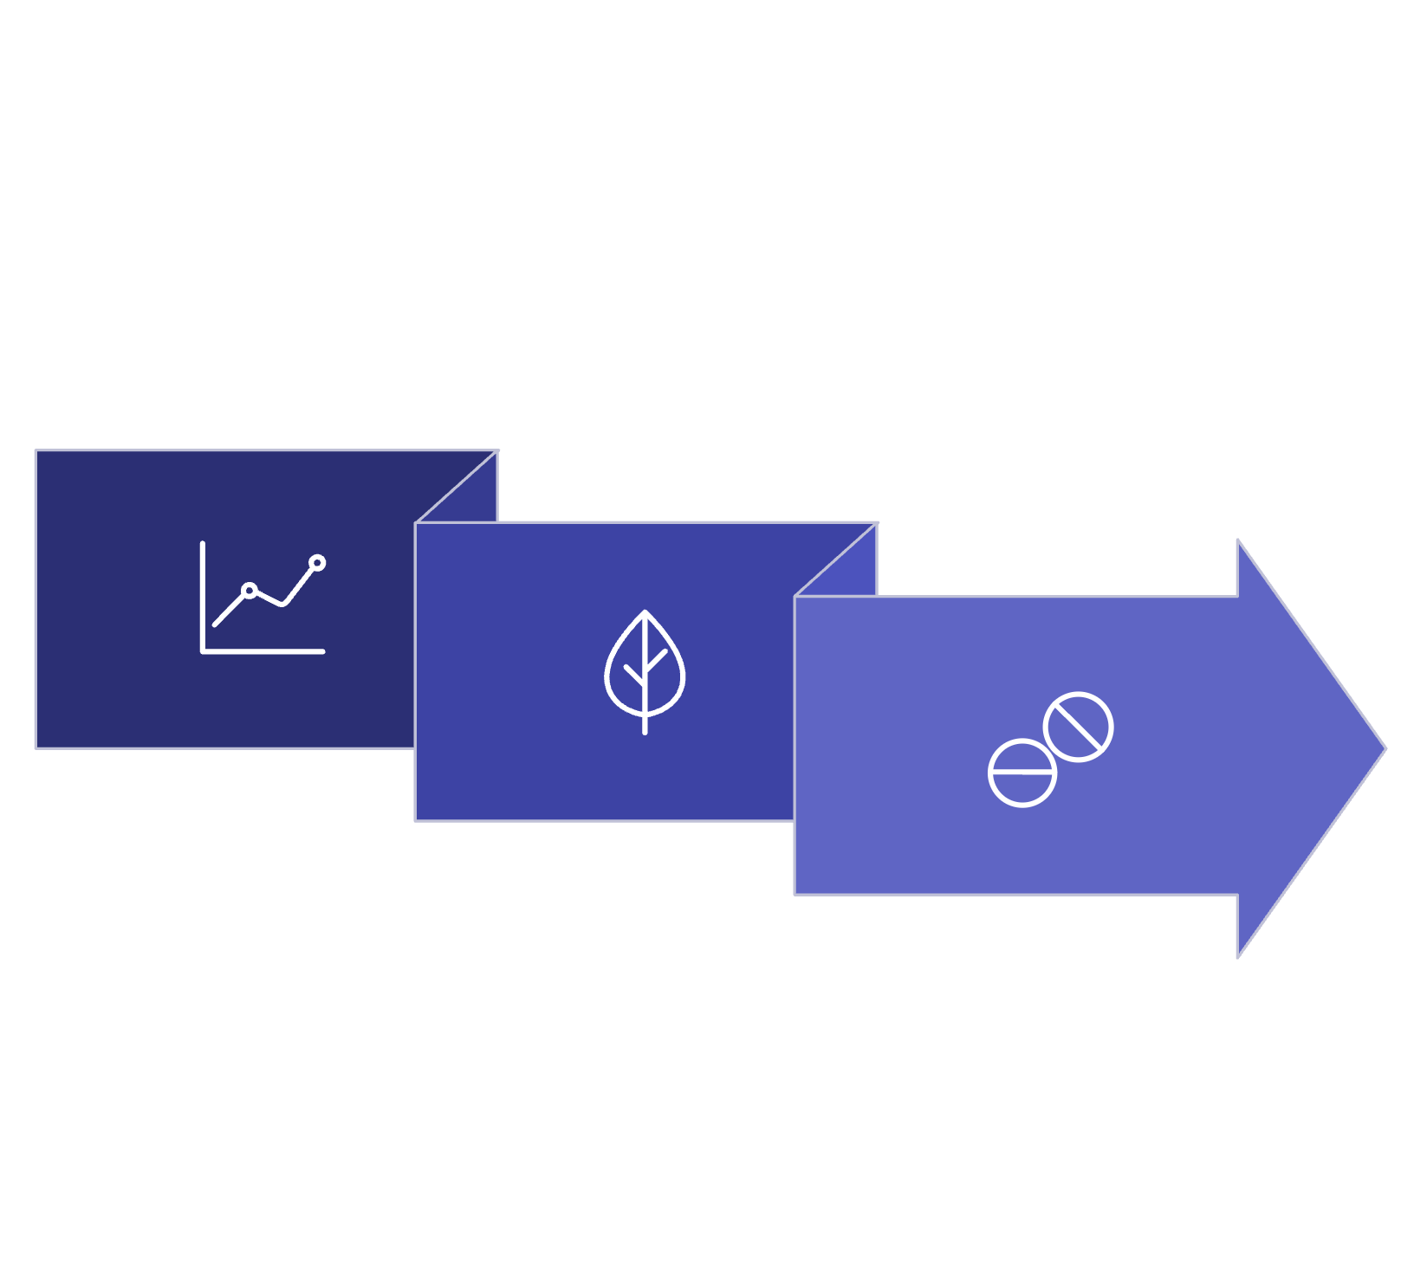
Multi-Modal System Architecture
Yield Forecasting
Unified Interface
Disease Detection
Slide 4 of 15
Notes:
Walk through the system architecture. The left stream shows yield forecasting: climate time series, soil features, and satellite NDVI data feed into LSTM/Transformer models to produce yield predictions with SHAP explanations. The right stream shows disease detection: smartphone leaf images are processed by a lightweight CNN to classify diseases with Grad-CAM visualizations. Both streams converge into a unified interface for farmers and extension agents, enabling integrated decision-making.

Slide 5
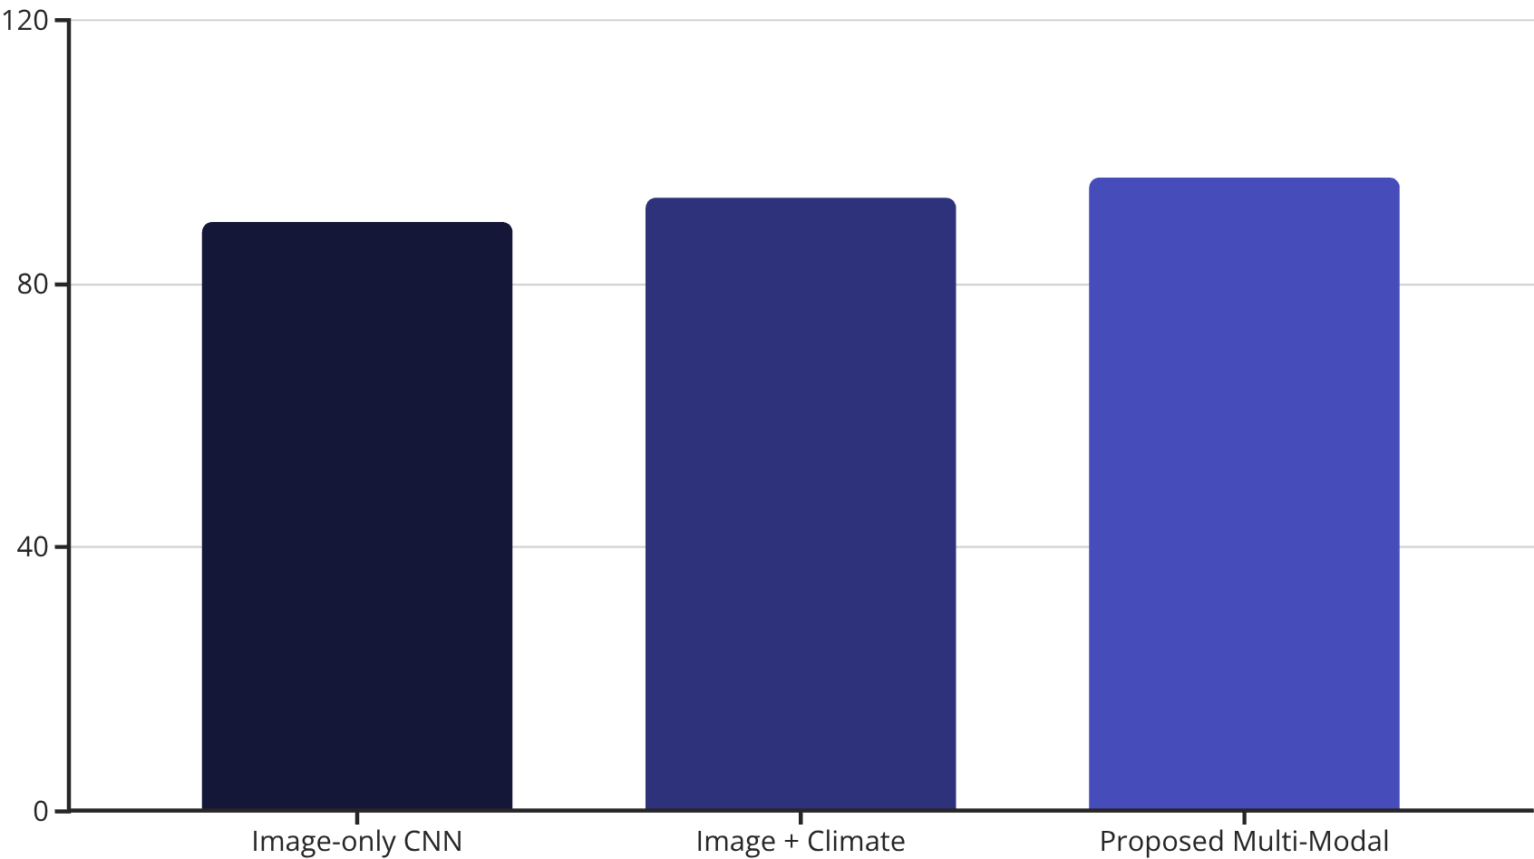
Disease Detection Performance
The performance of different models for disease detection was evaluated across key metrics, demonstrating the superior capability of the proposed multi-modal framework.
Model
Accuracy
Precision
Recall
F1-Score
Image-only CNN
89.4%
87.8%
86.3%
87.0%
Image + Climate
93.1%
91.6%
90.8%
91.2%
Proposed Multi-Modal
96.2%
95.1%
94.7%
94.9%
A bar chart visually highlights the accuracy comparison between the models.
The Proposed Multi-Modal model significantly outperforms both the Image-only CNN and the Image + Climate models in accuracy, precision, recall, and F1-score, confirming its effectiveness in disease detection.
Slide 5 of 15
Notes:
Present the disease detection results. The image-only CNN baseline achieved 89.4% accuracy. Adding climate context improved it to 93.1%. Our proposed multi-modal approach achieved 96.2% accuracy with 95.1% precision, 94.7% recall, and 94.9% F1-score. This demonstrates that integrating climate information with visual disease cues significantly improves detection performance. The improvement validates our multi-modal fusion strategy.

Slide 6
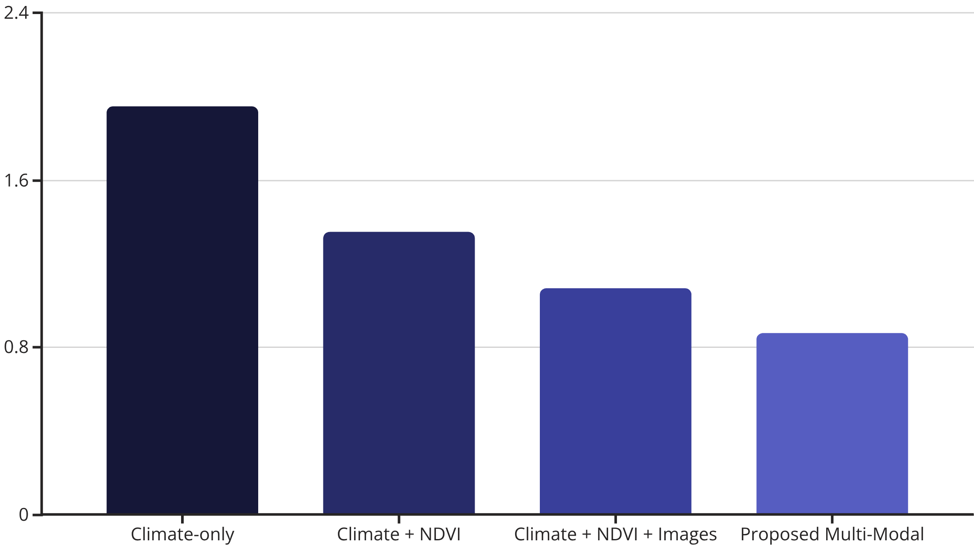
Crop Yield Forecasting Performance
RMSE Comparison (tons/ha) - Lower is Better
The proposed multi-modal model achieves the lowest error (0.87 tons/ha), demonstrating the value of fusing climate, NDVI, soil, and disease-related visual signals.
Slide 6 of 15
Notes:
Show the yield forecasting results measured in RMSE (Root Mean Square Error) in tons per hectare. Climate-only model: 1.95. Adding NDVI: 1.35. Adding images: 1.08. Our proposed multi-modal model: 0.87 tons/ha. Lower RMSE is better. This 55% improvement over climate-only demonstrates the critical value of fusing multiple data sources - climate, vegetation indices, soil properties, and disease-related visual signals - for accurate yield prediction.

Slide 7
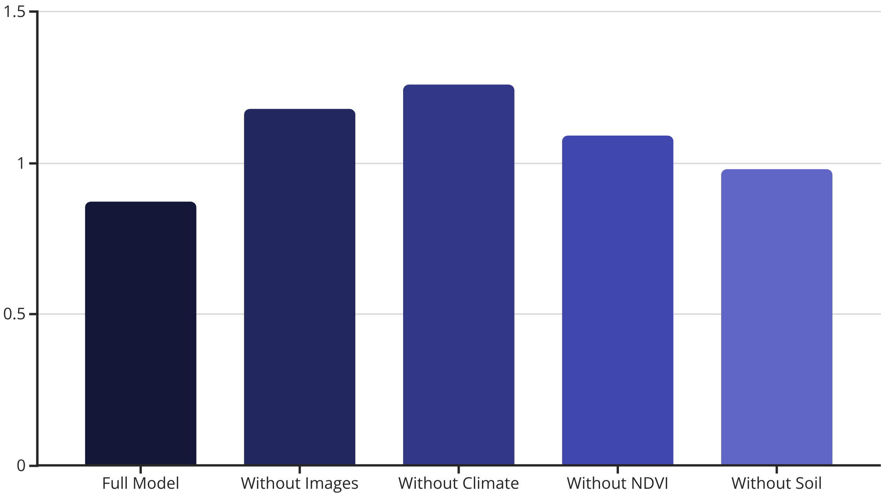
Ablation Study: Modality Contribution
Impact of Removing Each Input Modality on Yield Prediction (RMSE)
Removing image or climate inputs produces the largest degradation, indicating the importance of visual disease cues and climate variability in yield prediction.
Slide 7 of 15
Notes:
The ablation study removes one modality at a time to quantify its contribution. Full model RMSE: 0.87. Without images: 1.18 (36% degradation). Without climate: 1.26 (45% degradation). Without NDVI: 1.09 (25% degradation). Without soil: 0.98 (13% degradation). This shows that image and climate data are most critical. The large degradation when removing either confirms that both visual disease cues and climate variability are essential for accurate predictions.

Slide 8
Climate-Yield Correlations
Pearson Correlation Analysis with 95% Confidence Intervals
Variable
Pearson r
95% CI
p-value
Rainfall vs Yield
0.63
[0.54, 0.71]
<0.01
Temperature vs Yield
-0.48
[-0.60, -0.35]
<0.05
Key findings: Positive relationship between rainfall and yield, negative relationship between temperature and yield, both statistically significant.
Slide 8 of 15
Notes:
Present the statistical analysis of climate-yield relationships. Rainfall shows a strong positive correlation with yield (r=0.63, p<0.01) - more rainfall means higher yields. Temperature shows a negative correlation (r=-0.48, p<0.05) - excessive heat reduces yields. Both relationships are statistically significant with 95% confidence intervals. These findings align with agronomic knowledge and validate our model's ability to capture real climate-yield dynamics.

Slide 9
Explainable AI for Decision Support
SHAP (Feature Attribution)
Grad-CAM (Visual Explainability)
Identifies which variables drove the yield forecast - rainfall variability, average temperature during vegetative stages, and NDVI trends contribute strongly to predictions.
Highlights infected leaf regions rather than background areas, indicating symptom-focused attention.
User Trust: In a small user study, 82% of farmers reported higher confidence when explanations were provided alongside predictions.
Slide 9 of 15
Notes:
Explain our explainability approach. SHAP (SHapley Additive exPlanations) identifies which variables drove yield forecasts - rainfall variability, temperature during vegetative stages, and NDVI trends are top contributors. Grad-CAM (Gradient-weighted Class Activation Mapping) highlights which leaf regions influenced disease classification, showing the model focuses on disease symptoms rather than background. User study: 82% of farmers reported higher confidence in predictions when explanations were provided. This demonstrates that explainability is crucial for farmer adoption.

Slide 10
Robustness Under Real-World Conditions
Missing Data Robustness (Yield)
Domain Shift Robustness (Disease)
Practical Deployment Considerations
Evaluate performance when climate or soil variables are partially missing.
Evaluate performance across different image styles - varying camera quality, background clutter, and illumination conditions.
The framework is designed to handle incomplete data and real-world image variations, making it suitable for deployment in resource-constrained environments.
Slide 10 of 15
Notes:
Discuss robustness evaluation. Missing data robustness: we tested yield prediction when climate or soil variables were partially missing - the model maintains reasonable performance. Domain shift robustness: we evaluated disease detection across different image conditions - varying camera quality, background clutter, and lighting. These real-world challenges are critical for deployment in resource-constrained rural environments. Our framework is designed to handle incomplete data and image variations, making it practical for actual farm use.

Slide 11
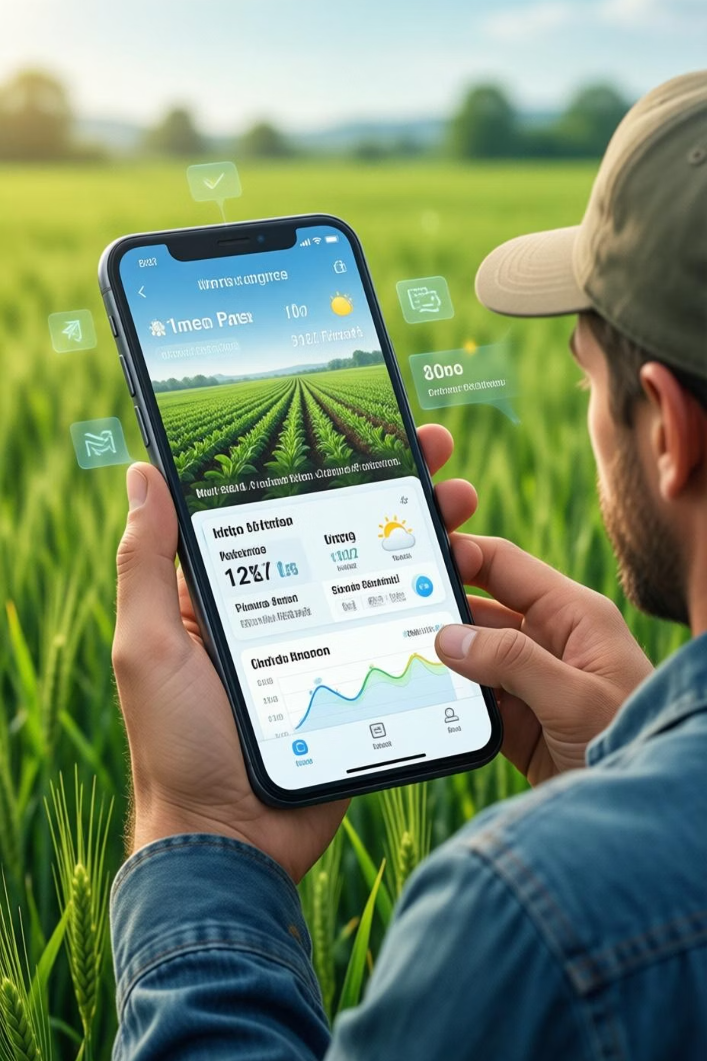
Web/Mobile Prototype for Farmers
User-Friendly Interface
Designed for farmers and extension agents with simple language and clear visualizations.
Yield Forecasting Module
Accept climate, soil, and location inputs; display yield predictions with SHAP explanations.
Disease Detection Module
Accept leaf image uploads; show disease predictions with Grad-CAM visualizations.
Integrated Workflow
Unified platform supporting crop planning, input timing, and early disease intervention decisions.
Slide 11 of 15
Notes:
Describe the practical deployment. The web/mobile prototype has a user-friendly interface designed for farmers and extension agents with simple language and clear visualizations. Yield forecasting module: farmers input climate, soil, and location data; the system displays yield predictions with SHAP explanations showing which factors matter most. Disease detection module: farmers upload leaf photos; the system identifies diseases with Grad-CAM visualizations highlighting affected areas. The integrated workflow supports crop planning, input timing decisions, and early disease intervention - all critical for improving farm productivity.

Slide 12
Key Findings and Impact
Superior Performance
Modality Importance
Explainability Builds Trust
Multi-modal fusion achieves 96.2% disease detection accuracy and 0.87 tons/ha yield prediction error.
Both visual disease cues and climate variability are critical for accurate predictions.
82% of farmers reported higher confidence with explanations.
Low-Cost Solution
Practical Deployment
Smartphone-based disease detection eliminates need for expensive sensors.
Web/mobile interface designed for rural accessibility and ease of use.
Slide 12 of 15
Notes:
Summarize key findings. Superior performance: 96.2% disease detection and 0.87 tons/ha yield error. Modality importance: both visual and climate data are critical. Explainability builds trust: 82% farmer confidence improvement. Low-cost solution: smartphone-based disease detection eliminates expensive sensors. Practical deployment: designed for rural accessibility. These findings demonstrate that our multi-modal, explainable approach is both technically superior and practically viable for smallholder farmers.

Slide 13
Future Work and Extensions
Expanded Data Inputs
Adding IoT sensors (soil moisture, pH) and additional satellite indices for richer signals.
Broader Crop Coverage
Expanding to more crops and disease types with severity estimation.
Enhanced Accessibility
Offline capability and Bangla-first multilingual interface for rural accessibility.
Privacy-Preserving Learning
Exploring federated learning for regional adaptation without centralizing sensitive farm data.
Integrated Advisory
Incorporating agronomic recommendations (spraying schedules, irrigation timing) aligned with local guidelines.
Slide 13 of 15
Notes:
Outline future directions. Expanded data inputs: integrate IoT sensors for soil moisture and pH, add more satellite indices. Broader crop coverage: extend to more crops and disease types, estimate severity levels. Enhanced accessibility: develop offline capability, create Bangla-first multilingual interface for rural users. Privacy-preserving learning: explore federated learning to adapt models regionally without centralizing sensitive farm data. Integrated advisory: incorporate agronomic recommendations for spraying schedules and irrigation timing aligned with local guidelines. These extensions will make the system more comprehensive and locally relevant.

Slide 14
Conclusion
This research proposes a practical and trust-oriented AI framework for climate-aware yield forecasting and smartphone-based disease detection.
Key objectives:
Reduce fragmentation in agricultural AI solutions.
Improve early intervention capability for disease management.
Support evidence-based decisions for smallholder farmers and extension services in Bangladesh.
Demonstrate the value of multi-modal fusion and explainable AI in real-world agricultural contexts.
Slide 14 of 15
Notes:
Conclude by restating the research objectives. We've proposed a practical, trust-oriented AI framework addressing fragmentation in agricultural AI. The system improves early intervention capability through integrated yield and disease prediction. It supports evidence-based decisions for smallholder farmers and extension services in Bangladesh. Most importantly, we've demonstrated the value of multi-modal fusion and explainable AI in real-world agricultural contexts. This research shows that AI can be both powerful and accessible for resource-constrained farming communities.

Slide 15

Thank You
Questions & Discussion
Abu Sadat Al Rafi, Mohammad Razaur Rashid, Md. Ahsan Kabir.
United International University (UIU), Dhaka, Bangladesh
Slide 15 of 15
Notes:
Thank the audience for their attention. Invite questions and discussion. Be prepared to discuss: technical details of the models, specific performance metrics, deployment challenges, farmer feedback, and next steps. Emphasize the collaborative nature of the research and the importance of stakeholder engagement for successful agricultural AI deployment.

